Slide 1
CAPSTONE PROJECT
Team 6

Slide 2
Project Link
Here is the google drive link to the project file:
https://drive.google.com/file/d/1JOFESEfZHu9WDZJbIeSDGGHU2JylsITh/view?usp=sharing

Slide 3
Project Overview
This is the final Capstone project on the 30-Day SQL and PowerBI Challenge. This is not a very detailed work for the topic but more of a data understanding phase.
The objective of this project is to understand the traffic in different boroughs of New York City and to try and categorize the various zones within various boroughs
We have used data generated by Uber, an online transportation network company. This data was obtained from the NYC Taxi Limousine Commission (TLC) by submitting a Freedom of Information Law request on July 20, 2015.

Slide 4
Data Understanding
The dataset downloaded contains, roughly, four groups of files:
Uber trip data from 2014 (April - September), separated by month, with location information (longitude - latitude values)
Uber trip data from 2015 (January - June), with less fine-grained location information
Non-Uber FHV (For-Hire Vehicle) trips. The trip information varies by company, but can include day of trip, time of trip, pickup location, driver's for-hire license number, and vehicle's for-hire license number.
Aggregate ride and vehicle statistics for all FHV companies (and, occasionally, for taxi companies)

Slide 5
Data Understanding
However, this project used two groups of files that was generated by Uber:
Uber trip data from 2014 (April - September)
Uber trip data from 2015 (January - June)
Uber trip data from 2015
Includes the file uber-raw-data-janjune-15.csv This file has the following columns:
Dispatching base num : The TLC base company code of the base that dispatched the Uber
Pickup date : The date and time of the Uber pickup
Affiliated base num : The TLC base company code affiliated with the Uber pickup
locationID : The pickup location ID affiliated with the Uber pickup

Slide 6
Data Understanding
Uber trip data from 2014
There are six files of raw data on Uber pickups in New York City from April to September 2014 (uber-raw-data-xyz14.csv). The files are separated by month and each has the following columns:
Date/Time : The date and time of the Uber pickup
Lat : The latitude of the Uber pickup
Lon : The longitude of the Uber pickup
Base : The TLC base company code affiliated with the Uber pickup
For coarse-grained location information from the pickups in 2015, the file taxi-zone-lookup.csv shows the taxi Zone (essentially, neighborhood) and Borough for each locationID contained in the Uber trip data from 2015.

Slide 7
Database
As part of the project, we are supposed to create a database to test our knowledge of SQL.
Attached is a database named New_York_Uber_Db.
It contains two tables, i.e., uber-raw-data-janjun-15 and taxi-zone-lookup.
The two tables have a relationship through the column Location_ID, which is common on both tables.
Data from the CSV files were imported to populate the tables with the appropriate information. This was done with the help of the import functionality in MySQL Workbench.

Slide 8
Data Preparation
For this project, we chose the data source to be the csv files.
We loaded the csv files to PowerBI, where we performed:
Data cleaning: removal of duplicate rows, Handle missing values in columns. Ensure that columns have the right data types.
Data Transformation: Create a date table with a range of dates that cover the range of dates in our dataset.
Create calculated columns and measures. With the help of the DAX querying language, we created measures to facilitate analysis. Eg., Pickup_Count = COUNTROWS('uber-raw-data-janjune-15')

Slide 9

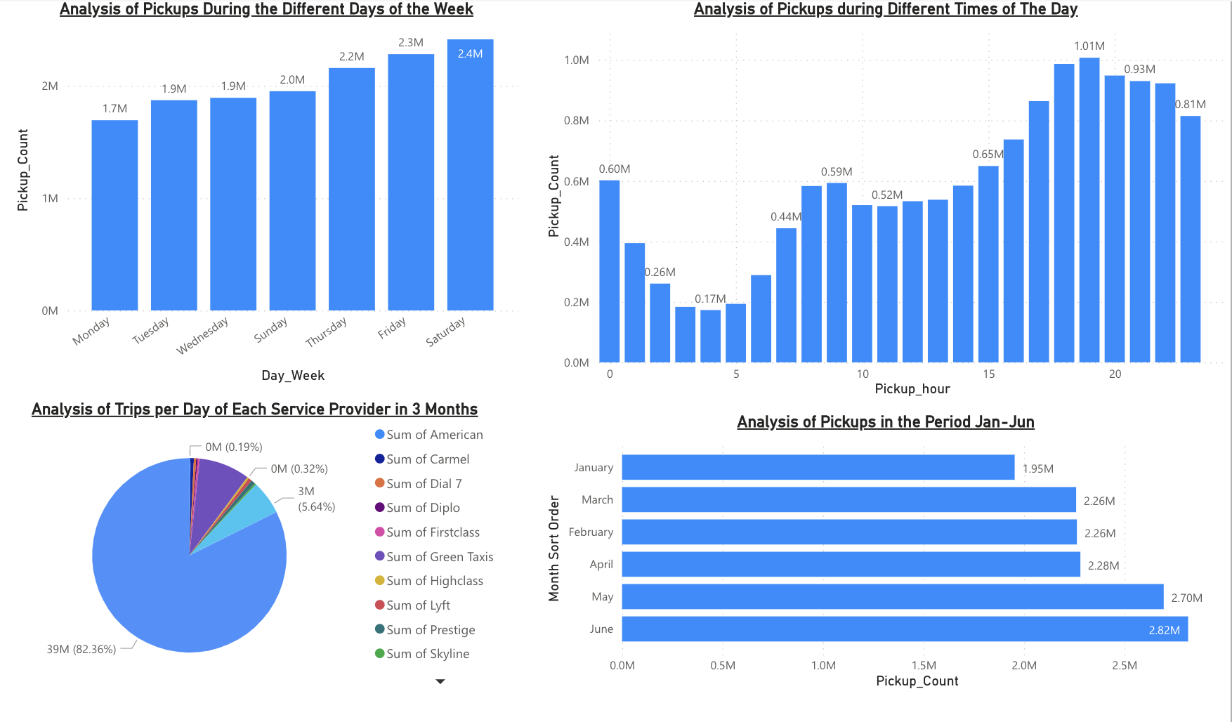
UBER DASHBOARD

Slide 10
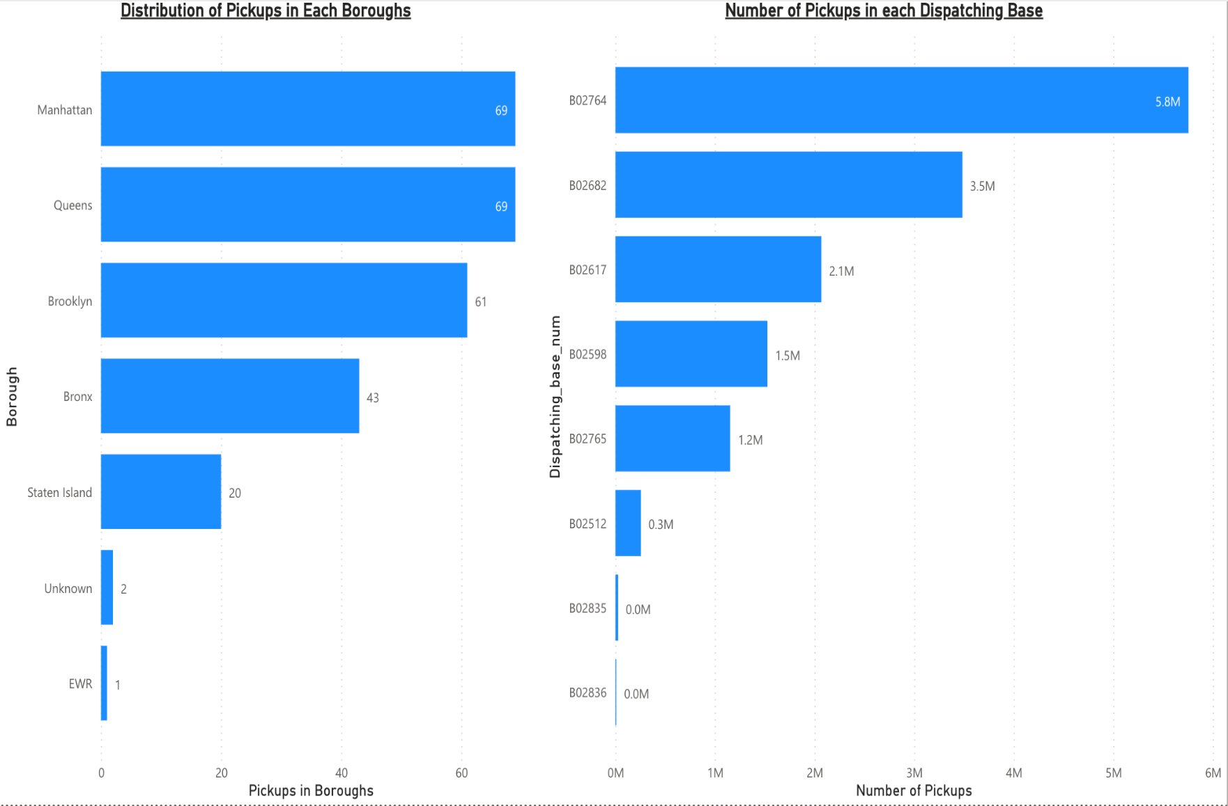
UBER DASHBOARD

Slide 11
General Insights
Analysis of Pickups During the Different Days of the Week
At 2,414,563, Saturday had the highest Pickup_Count and was 42.51% higher than Monday, which had the lowest Pickup_Count at 1,694,252. This indicates that Saturdays has the highest demand for ubers while Mondays have the lowest.
Saturday accounted for 16.92% of Pickup_Count.
Across all 7 days of the week, the number of pickups ranged from 1,694,252 to 2,414,563.
There is an increase in demand for uber from Monday to Saturday, but the demand drops on Sunday and drops further on Monday.

Slide 12
General Insights
2. Analysis of Pickups During Different Times
At the 19th hour or 1900hrs, the demand of uber was at high with 1,007,464 pickups while 0400hrs recorded the lowest demand for uber with 173,038 pickups being recorded.
From 1900hrs to 0400hrs, there was a decrease in pickups.
After 0400hrs the number of pickups start to increase until 0900hrs after which there is a slight decrease in the number of pickups.
After 1000hrs there is a steady increase in the number of pickups till 1900hrs.
This analysis shows the peak and also off-peak hours.

Slide 13
General Insights
3. Analysis of Trips per Der Day of Each Service Provider in 3 Months
The pie chart shows the distribution of the pickups among the service providers with the Yellow Taxis taxis taking most of the share with 38,768,702 pickups (82.36%).
The Green taxis come second with 3,975,664 (8.45%) pickups while Uber came third with 2,653,532 (5.64%) pickups.
This is important to see the performance of Uber alongside other service providers.

Slide 14
General Insights
4. Analysis of Pickups in the period Jan-June
This is the monthly comparison of the uber trips.
The month of June recorded the highest number of trips, 2,816,895 while January recorded the lowest number of trips 1,953,801.
The number of increase in number of trips from January to February.
The number of trips decreased from February to March.
The number of trips increased from March to June.

Slide 15
General Insights
5. Number of Pickups per Boroughs
This is an analysis of the number of pickups in each boroughs.
At 10,371,060, Manhattan had the highest number of Pickups while EWR had the lowest number of pickups with just 105.
Manhattan Accounted for 72% of the number of pickups.

Slide 16
General Insights
6. Number of Pickups in each Dispatching Base
This is an analysis of the number of pickups in each dispatching base.
At 5,753,653, dispatch base B02764 had the highest number of Pickups while B02836 had the lowest number of pickups with just 1,990.
The distribution of the pickups in each dispatching base was not balanced since one base has a very high number of pickups while the another has a very low number of pickups.

Slide 17
Additional Insights
How Each Day Perfomed in the Various Months
There was a variation in number of pickups in different days of the week in different months. For example:
In January, Saturday recorded the highest number of pickups with 392,900 pickups while Monday had the lowest with 194,004 pickups.
In February, Saturday recorded the highest number of pickups with 375,296 pickups while Monday had the lowest with 279,665 pickups.
In March, Tuesday recorded the highest number of pickups with 353,412 pickups while Wednesday had the lowest with 281,583 pickups.

Slide 18
Additional Insights
In April, Thursday recorded the highest number of pickups with 406,837 pickups while Monday had the lowest with 253,079 pickups.
In May, Saturday recorded the highest number of pickups with 507,666 pickups while Monday had the lowest with 271,919 pickups.
In June, Tuesday recorded the highest number of pickups with 445,025 pickups while Wednesday had the lowest with 359,703 pickups.

Slide 19
DATA CHALLENGES
Data Quality Issues: When working with the data, we encountered missing records and duplicate records.
Data Volume: Handling large volumes of data may require optimization to ensure performance in Power BI.
Handling Null or Anomalous Data: Some trips were incomplete. Deciding how to handle null or anomalous data was a challenge, as it can affect the accuracy of our analysis.
Geospatial Data Challenges: When working with location data, geospatial challenges can arise, including coordinate transformation, mapping, and visualization. This could be much easier if we were using a programming language

Slide 20
Lessons Learned
Data Cleaning is Essential: We cannot emphasize enough how crucial effective data cleaning is. An analysis's quality can be significantly impacted by inconsistent or erroneous data..
Data Transformation is Key: Data often needs to be transformed to be useful. Whether it's changing data types, creating calculated columns, or joining tables, data transformation is a critical part of the process.
Power BI Skills: One must have enhanced their skills in Power BI, including using DAX (Data Analysis Expressions) for creating calculated columns and measures.
Data Challenges are Normal: Projects using data rarely go as expected. Working with real-world data presents a number of frequent difficulties, such as missing data, discrepancies, and data quirks, which we encountered.

Slide 21
Lessons Learned
Domain Knowledge: Gaining domain knowledge can significantly improve the quality of your analysis. In this case, we googled more to understand some terms in the taxi and ride-sharing industry.
Continual Learning: Data analysis is an ever-evolving field and you need to be always updated with the tools and techniques

Slide 22
Future Works
Geospatial Analysis: Explore geospatial patterns by mapping pickup and drop-off locations to identify traffic hotspots, high-demand zones, or areas with insufficient driver coverage.
Time Series Analysis: Perform time series analysis to identify seasonal patterns, trends, and cyclical behaviors in ride demand over time.
Route Optimization: Optimize the recommended routes for Uber drivers based on historical traffic data. This can help reduce travel time and improve the overall rider experience.
Impact of Events: Analyze how local events, such as sports games, concerts, or festivals, affect ride demand and traffic congestion. Uber could adjust its operations based on such events.

Slide 23
Thank you
Team Members: Noella Mutuku Mandela Ngatia
Douglas Kimathi

